Slide 1
Operating Systems
Memory Management（1）
Again:4 5 10 12 13 15 18 19 26 27 29 30 32 34 36 38 39 40
47 48 49 53 54 57 60-63 65 66 68 69 71-76
Liu Fagui

Slide 2
Content of the Lecture
Review
No Memory Abstraction
Memory Abstraction: address space
  address space
  Swapping
  Memory Management (free space)
Virtual Memory and Paging
  Overlaying
  Paging
  Page Table and TLB
Page Replacement
Summary

Slide 3
Review
Deadlock
The Ostrich Algorithm
Deadlock detection & deadlock recovery
Deadlock avoidance
Deadlock prevention

Slide 4
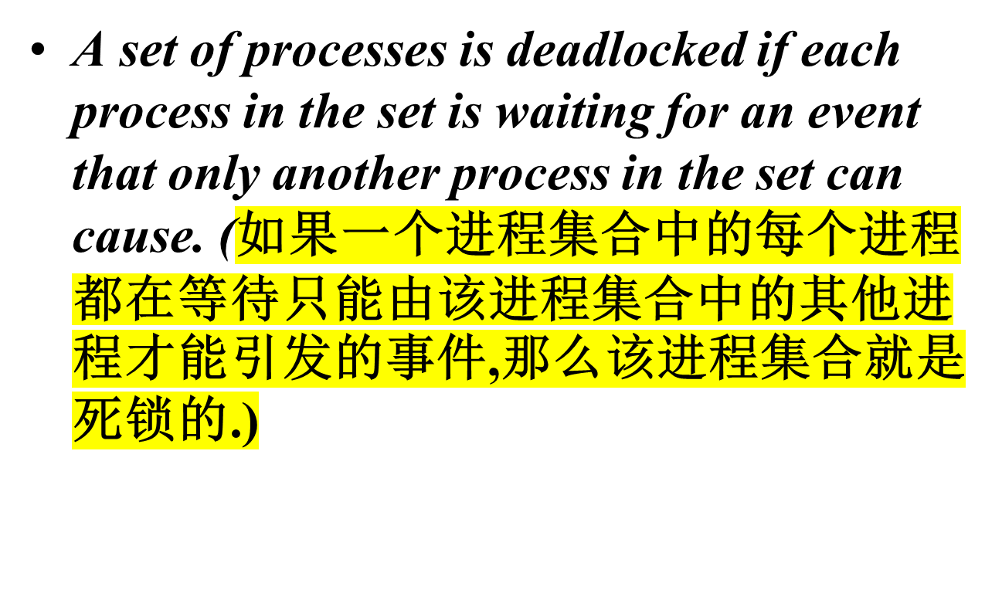
Deadlock

Slide 5
Strategies for dealing with deadlocks
Just ignore the problem.
Detection and recovery. Let deadlocks occur, detect them, take action.
Dynamic avoidance by careful resource allocation. (Avoidance)
Prevention, by structurally negating one of the four required conditions.

Slide 6
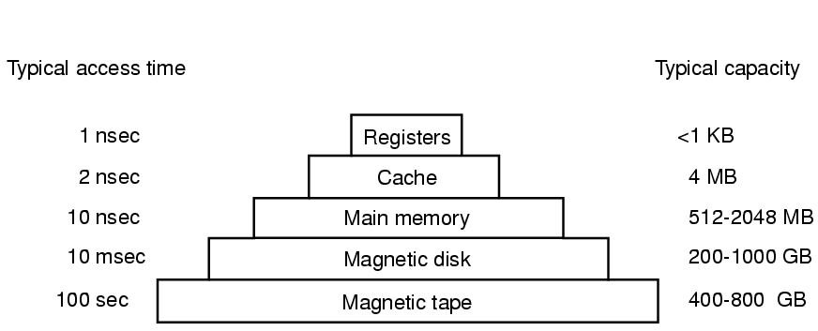
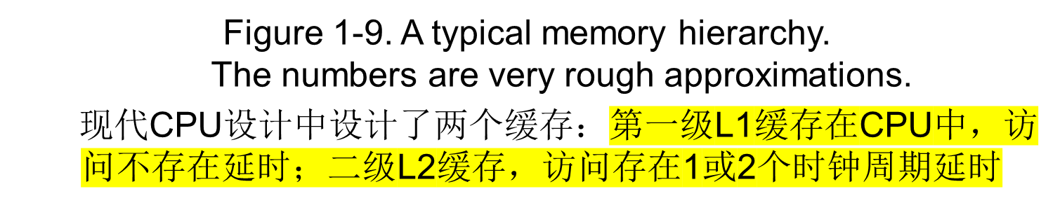
Memory
1~8GB
1~4TB
Notes:
CPU的寄存器。其典型容量是：在32位CPU中为32╳32位，而在64位CPU中为64╳64位，这两种情形下，其容量都小于1KB.

Slide 7
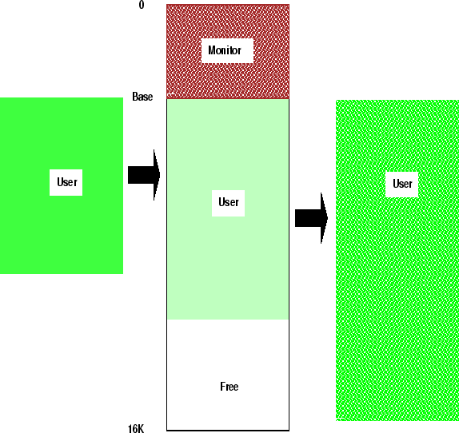
Memory Manager
Manage memory hierarchy
  Monitor used and free memory
  Allocate memory to processes
  Reclaim (De-allocate) memory
  Swapping between main memory and disk

Slide 8
General Memory Problem
We have a limited (expensive) physical resource: main memory
We want to use it as efficiently as possible
We have an abundant (丰足的）, slower resource: disk
希望内存：私有的、容量无限的、速度无限快的、永久性存储器

Slide 9
Content of the Lecture
Review
No Memory Abstraction
Memory Abstraction: address space
  address space
  Swapping
  Memory Management (free space)
Virtual Memory and Paging
  Overlaying
  Paging
  Page Table and TLB
Page Replacement
Summary

Slide 10

No Memory Abstraction
Figure 3-1. Three simple ways of organizing memory with an operating system and one user process.
(a)OS at the bottom of memory in RAM (Random Access Memory); was used in mainframes and minicomputers; not used anymore
(b)OS is in ROM (Read-Only Memory) at the top of memory; is used in some palm-tops and embedded systems (用于掌上电脑和嵌入式系统）
(c)Device drivers are in ROM at the top of memory and the rest is in RAM; was used by early PCs (e.g., running MS-DOS), where the portion in the ROM is called BIOS.

Slide 11
Mono-programming without Swapping
Run one process at a time
  simplest possible memory management scheme
Memory is shared only between OS and the process.
Three different ways to organize memory:
  OS at the bottom of memory in RAM (Random Access Memory); was used in mainframes and minicomputers; not used anymore
  OS is in ROM (Read-Only Memory) at the top of memory; is used in some palm-tops and embedded systems
  Device drivers are in ROM at the top of memory and the rest is in RAM; was used by early PCs (e.g., running MS-DOS), where the portion in the ROM is called BIOS (Basic Input Output System).
  第一种和第三种方案的缺点是用户程序出现错误可能摧毁OS,引发灾难性后果（如篡改磁盘）。
  在无内存抽象的系统中如何实现并行？

Slide 12
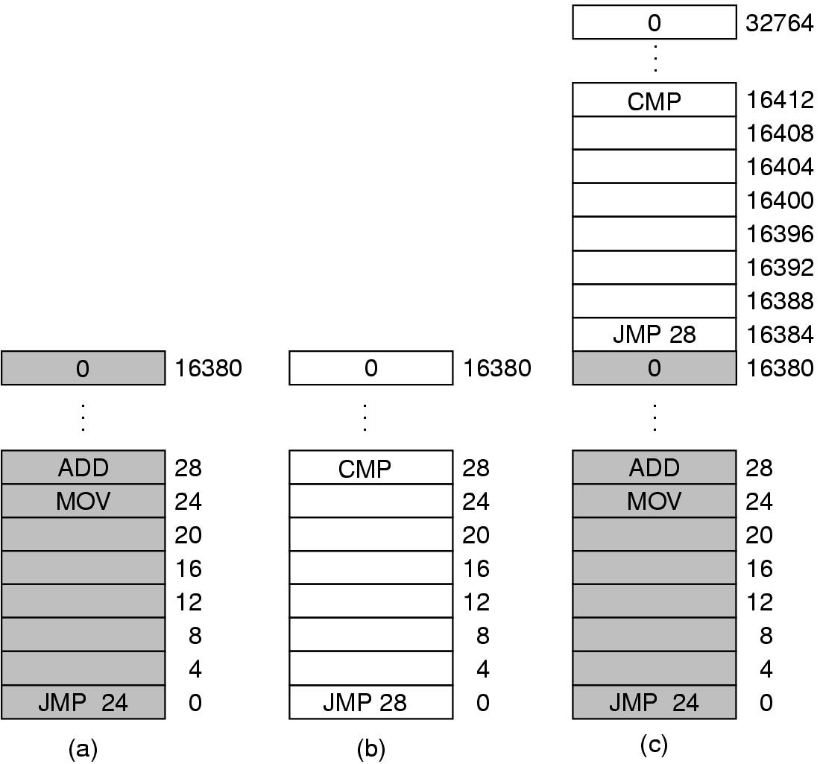
Multiple Programs Without Memory Abstraction
2.两程序连续装载、并由于内存键不同而不会破坏对方的内存。但在第一个程序运行一段时间后，OS开始运行第2个程序，执行JMP 28→ADD(第一程序）
Illustration of the relocation problem.
解决方法:静态重定位（+16384)）.但装载器需要区别地址与常数
如MOV REGISTER1, 28中的28是数而非地址
1.内存被划分成2KB的块，每个块被分配一个一个4位的保护键，保护键存在CPU的特殊寄存器中。
a)一个16KB程序 b)另一个16KB程序 c)两个程序连续地装载到内存中
3.缺少内存抽象在嵌入式系统和智能卡系统中是很常见的。

Slide 13
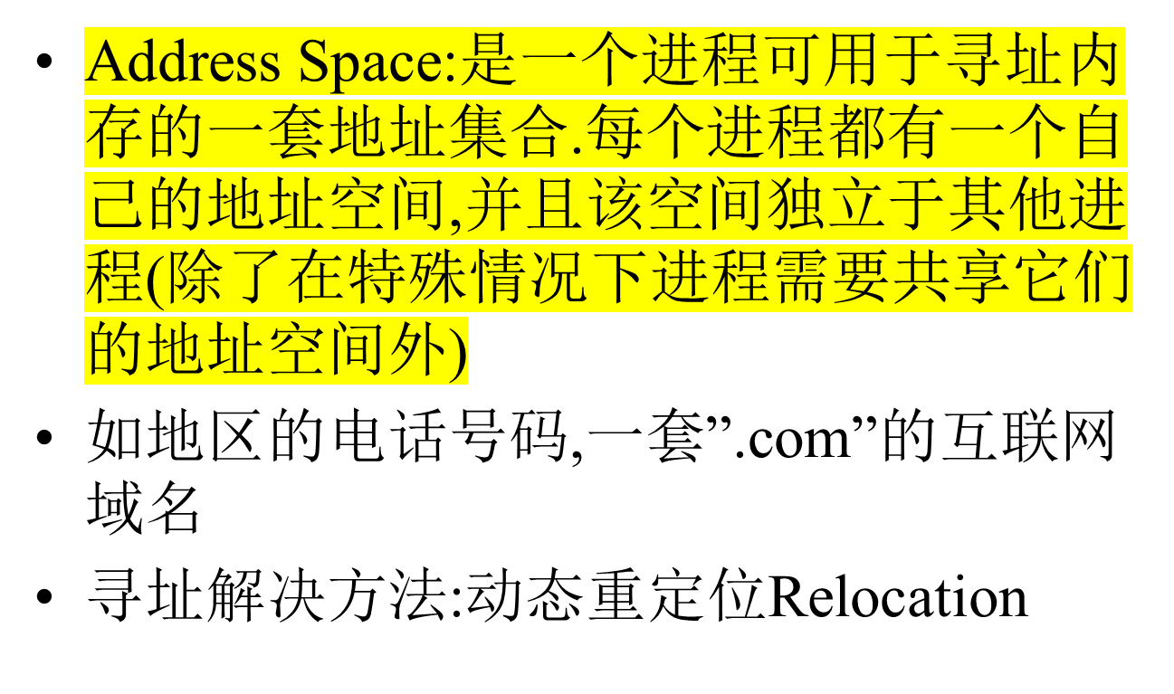
Memory Abstraction: address space

Slide 14
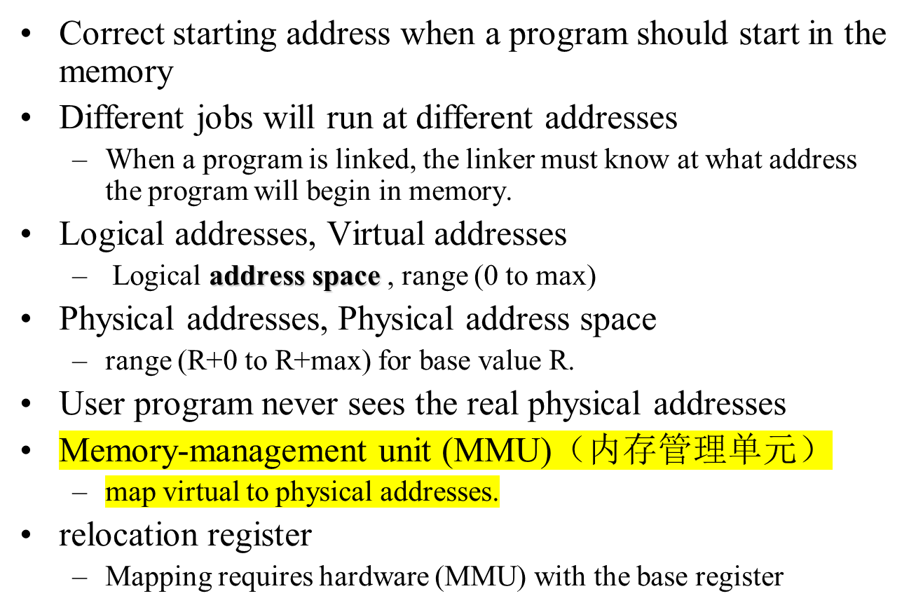
Relocation

Slide 15

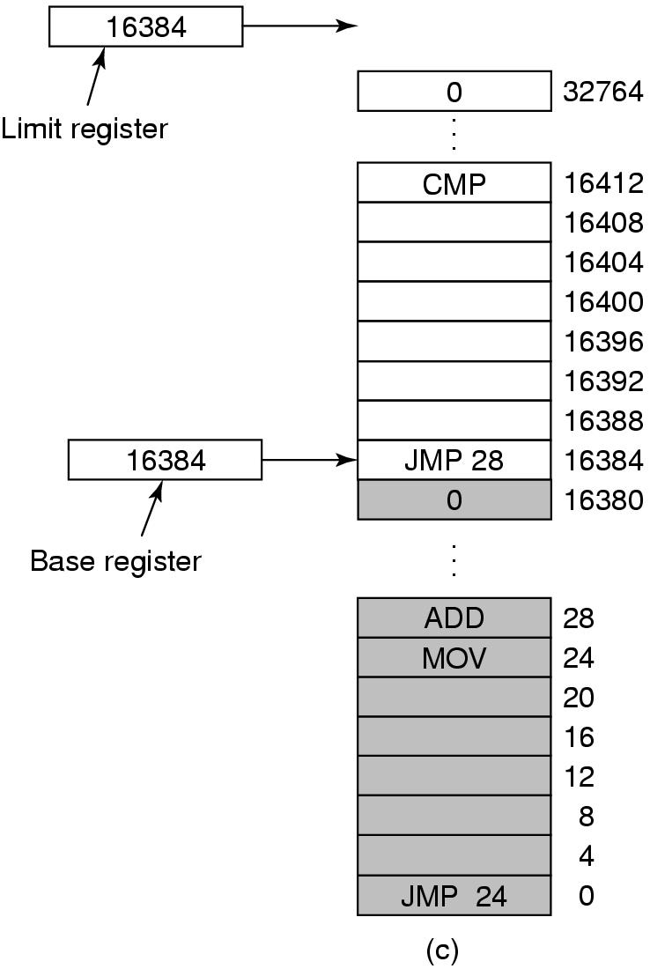
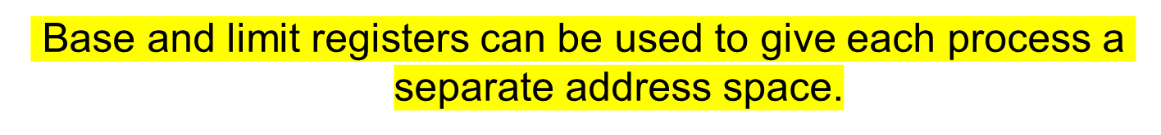

Slide 16
Relocation Register
Base Register
Memory
BA
CPU
Instruction
Address
Logical
Address
Physical
Address
+
MA
MA+BA

Slide 17

Protection
Problem:
  How to prevent a malicious （恶意）process to write or jump into other user's or OS partitions
Solution:
  Base bounds registers

Slide 18

Bounds Register
Base Register
Memory
Base Address
Logical
Address LA
Base
Address
BA
CPU
Address
<
+
MA+BA
Memory
Address
MA
Physical
Address
PA
Limit Address
Fault

Slide 19
Swapping（交换）
----处理内存超载方法之一
Move a part of or the whole process to disk
Allows several processes to share a fixed partition
Processes that grow can be swapped out and swapped back in a bigger partition

Slide 20
Swapping (2)
Monitor
Disk
User 1
User
Partition

Slide 21
Swapping (3)
Monitor
Disk
User 1
User 1
User
Partition

Slide 22
Swapping (4)
Monitor
Disk
User 1
User 1
User
Partition
User 2

Slide 23
Swapping (5)
Monitor
Disk
User 1
User 2
User
Partition
User 2

Slide 24
Swapping (6)
Monitor
Disk
User 1
User 2
User
Partition
User 2

Slide 25
Swapping (7)
Monitor
Disk
User 1
User 1
User
Partition
User 2

Slide 26

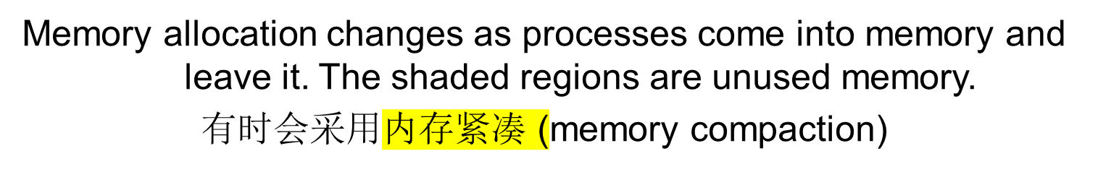
Swapping (8)

Slide 27

Swapping (9)
存放普通局部变量和返回地址的队栈
动态分配和释放使用的堆
(a) Allocating space for growing data segment.
(b) Allocating space for growing stack, growing data segment.

Slide 28
Compaction (Similar to Garbage Collection)
Assumes programs are all relocatable
Processes must be suspended during compaction
Need be done only when fragmentation gets very bad
5
Monitor
Job 7
Job 5
Job 3
Job 8
Free
Job 6
6
Monitor
Job 7
Job 5
Job 3
Job 8
Free
Job 6
7
Monitor
Job 7
Job 5
Job 3
Job 8
Free
Job 6
8
Monitor
Job 7
Job 5
Job 3
Job 8
Free
Job 6
9
Monitor
Job 7
Job 5
Job 3
Job 8
Job 6
Free

Slide 29
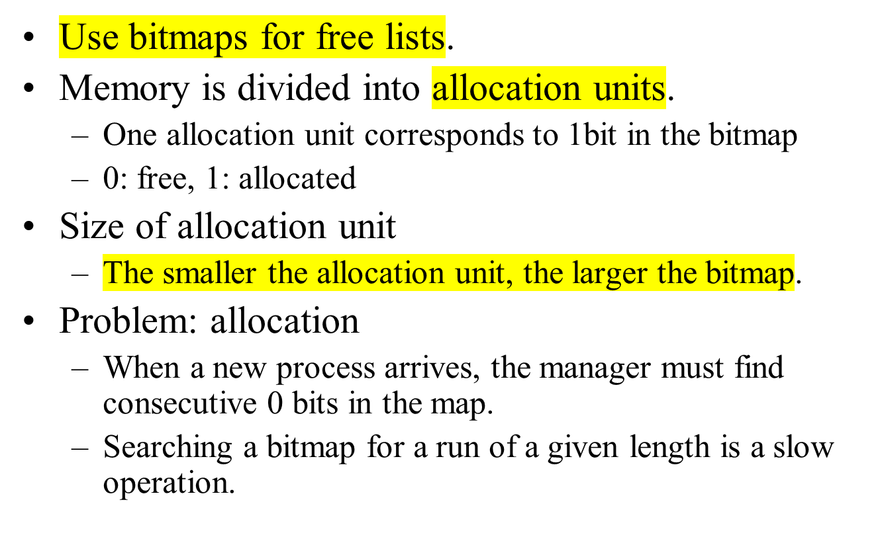
Memory Management with Bitmaps
1
0
1
0
1
0
0
0
1
0
1
0
0
1
0

Slide 30
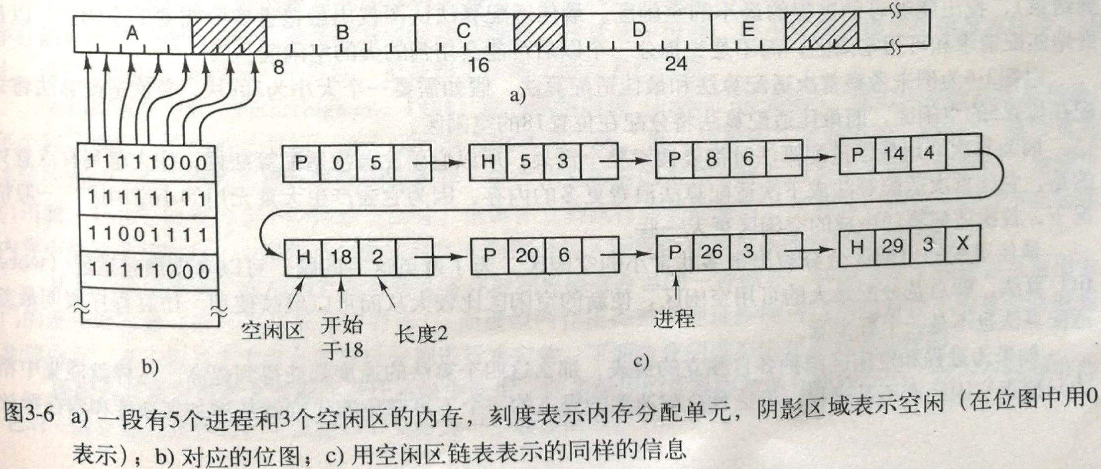
Memory Management with Bitmaps
(a) A part of memory with five processes and three holes. The tick marks show the memory allocation units. The shaded regions (0 in the bitmap) are free. (b) The corresponding bitmap. (c) The same information as a list.

Slide 31
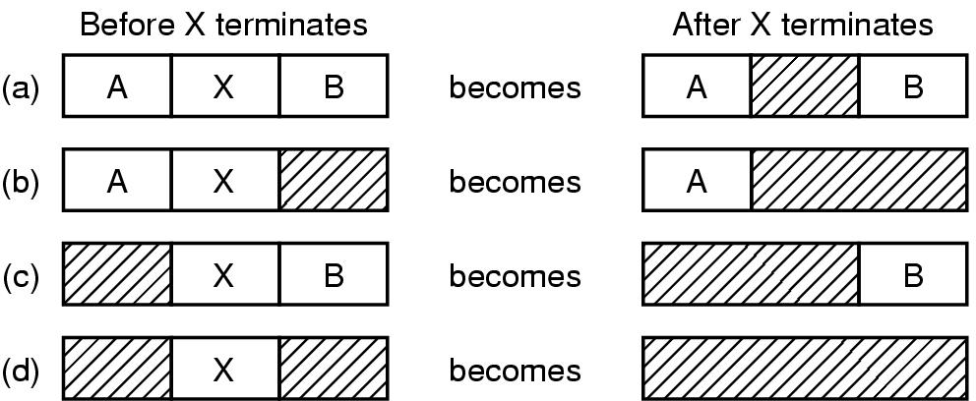
Memory Management with Linked Lists
Use a linked list of allocated and free memory segments (called hole)
  sorted by the address or by the size
Four neighbor combinations for the terminating process X

Slide 32
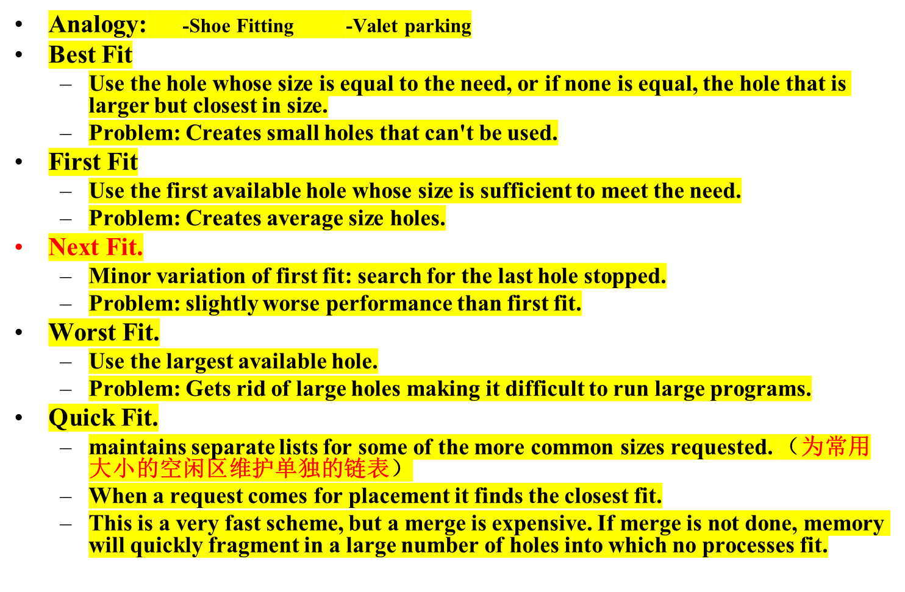
Storage Placement Strategies

Slide 33
Lots of Variants
Many programs, total size less than memory
  Technically possible to pack them together
  Will programs know about each other’s existence?
One program, using lots of memory
  Can you only keep part of the program in memory?
Lots of programs, total size exceeds memory
  What programs are in memory, and how to decide?

Slide 34

Secondary Storage
Main Program
Overlay 1
0K
5k
Overlay Manager
Overlay 2
7k
Overlay Area
Overlay 1
Overlay 2
Overlay 3
Overlay 1
12k
Overlay 3

Slide 35
Storage Management Problems
Compaction suffers from overhead
Overlays are painful to program efficiently
Swapping requires writing to disk sectors

Slide 36
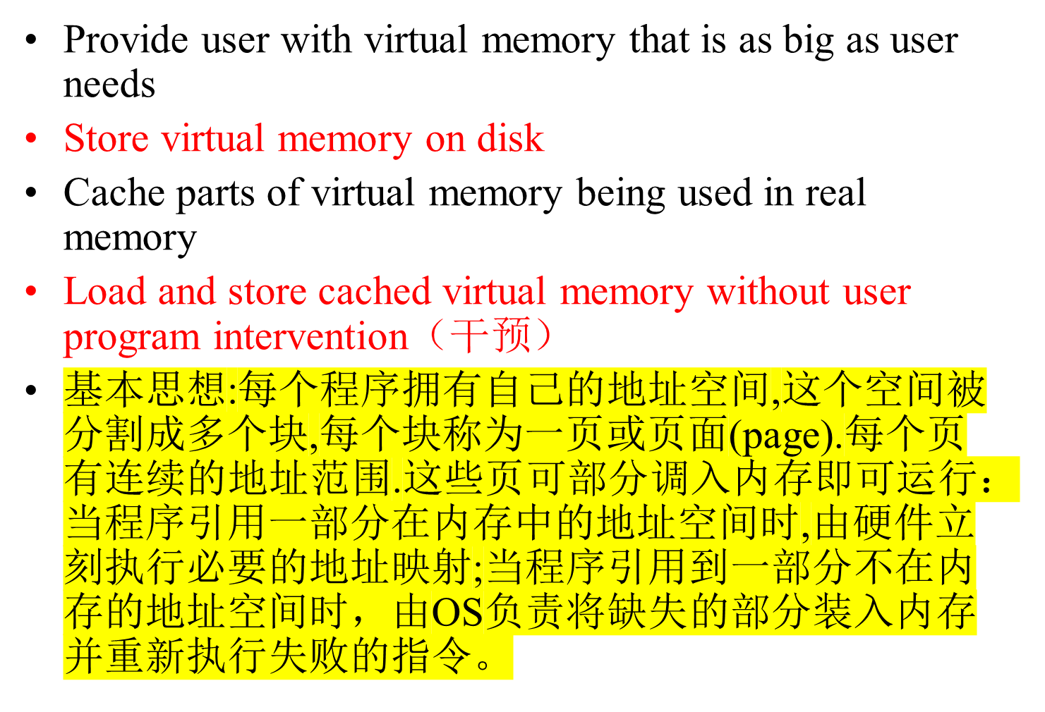
Virtual Memory

Slide 37
Benefits of Virtual Memory
Use secondary storage($)
  Extend DRAM($$$) with reasonable performance
Protection
  Programs do not step over each other
Convenience
  Flat address space(单一地址空间）
  Programs have the same view of the world
  Load and store cached virtual memory without user program intervention （无用户程序的干涉）
Reduce fragmentation:
  make cacheable units all the same size (page)
Remove memory deadlock possibilities:
  permit pre-emption of real memory

Slide 38

Virtual Memory – Paging (分页)
The position and function of the MMU
---– shown as being a part of the CPU chip (it commonly is nowadays). Logically it could be a separate chip, was in years gone by.

Slide 39
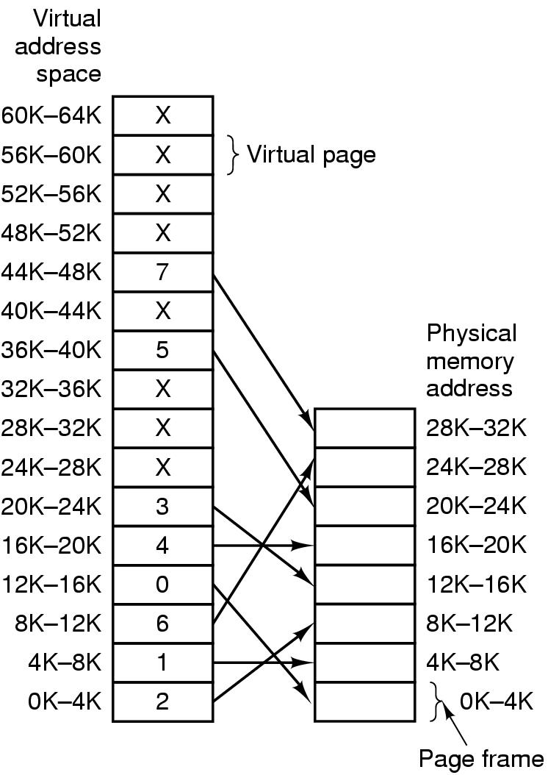

Paging (2) PAGE-SIZE 4096
(1)MOV REG, 0
访问0地址时
0->2 (8192)
(2) MOV REG, 8192
2->6 (24576)
(3) MOV REG, 32780
----缺页中断(第8页）
Figure 3-9. Relation between virtual addresses and physical memory addresses given by page table.

Slide 40

Paging (3)
16位:其中4位(页号) +12位(页内地址)
The internal operation of the MMU with 16 4-KB pages.

Slide 41
Paging Request
Real Memory
Request Page 3
Page Table
1
Memory
VM
Frame
3
1
2
2
3
3
1
2
3
4
4
4
Virtual Memory Stored on Disk
Disk
1
2
3
4
5
6
7
8

Slide 42
Paging
Real Memory
Request Page 1
Page Table
1
Memory
VM
Frame
3
1
2
1
2
3
3
1
2
3
4
4
4
Virtual Memory Stored on Disk
Disk
1
2
3
4
5
6
7
8

Slide 43
Paging
Real Memory
Request Page 6
Page Table
1
Memory
VM
Frame
3
1
2
1
2
6
3
3
1
2
3
4
4
4
Virtual Memory Stored on Disk
Disk
1
2
3
4
5
6
7
8

Slide 44
Paging
Real Memory
Request Page 2
Page Table
1
Memory
VM
Frame
3
1
2
1
2
6
3
3
1
2
3
4
2
4
4
Virtual Memory Stored on Disk
Disk
1
2
3
4
5
6
7
8

Slide 45
Paging
Real Memory
Request Page 8: Swap page 2
to disk first
Page Table
1
Memory
VM
Frame
3
1
2
1
2
6
3
3
1
2
3
4
2
4
4
Virtual Memory Stored on Disk
Disk
1
2
3
4
5
6
7
8

Slide 46
Paging
Real Memory
Load Page 8 to Memory
Page Table
1
Memory
VM
Frame
3
1
2
8
2
6
3
3
1
2
3
4
2
4
4
Virtual Memory Stored on Disk
Disk
1
2
3
4
5
6
7
8

Slide 47
Page Mapping Hardware
Virtual Memory
Virtual Address (P,D)
Page Table
P
P
D
0
D
P
1
Contents(P,D)
0
P-> F
1
1
0
Physical Memory
1
F
D
F
Physical Address (F,D)
Contents(F,D)
D

Slide 48
Page Mapping Hardware
Virtual Memory
Virtual Address (004006)
Page Table
004
004
006
0
006
4
1
Contents(4006)
0
4-> 5
1
1
0
Physical Memory
1
005
006
005
Physical Address (F,D)
Page size 1000
Number of Possible Virtual Pages 1000
Number of Page Frames 8
Contents(5006)
006

Slide 49

高速缓冲
禁止位(禁止该页面被高速缓存）
修改位（或脏位）
“在/不在”位（存在位）
页框号
保护位
访问位
Figure 3-11. A typical page table entry

Slide 50
Protection
Can add read, write, execute protection bits to page table to protect memory
Check is done by hardware during access
shared memory location
  different protections from different processes
  Solution:
    associate protection lock with page frame. Each process has its own key. If the key fits the lock, the process may access the page frame
<number>/73

Slide 51
Protection
Typically many different keys can fit a lock using a priority numbering scheme
(E.G. Key 3 fits all locks 3, 7, 15
Key 4 fits 5,6,7,12,13,14,15.)
<number>/73

Slide 52




Keys and Locks
Process A
Keys
Page Frames
Process B
<number>/73

Slide 53
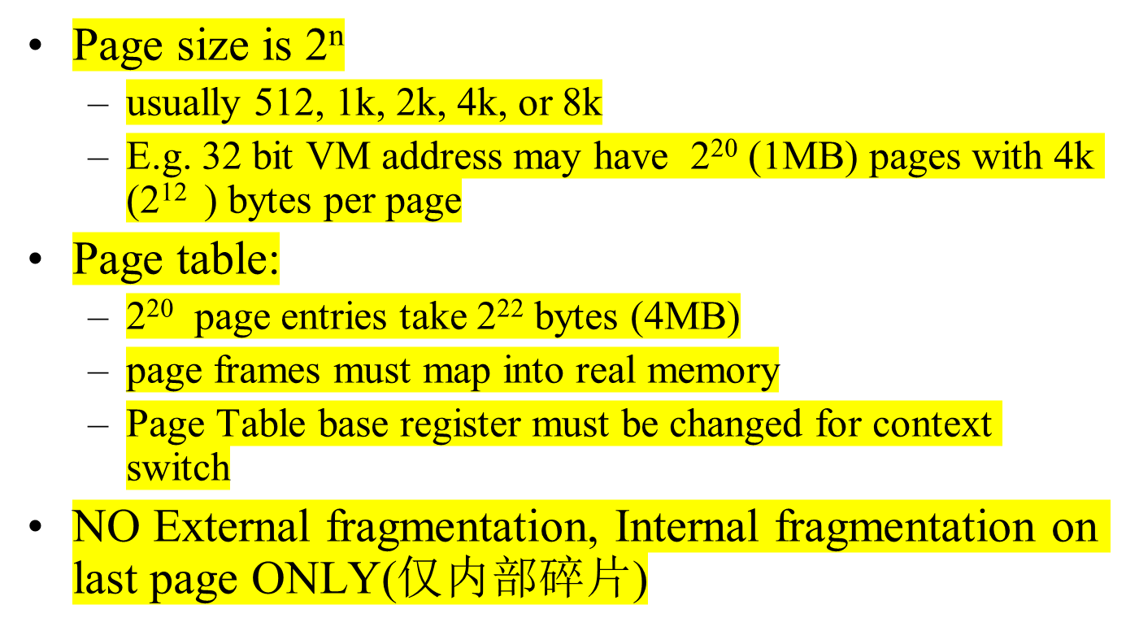
Paging Issues

Slide 54
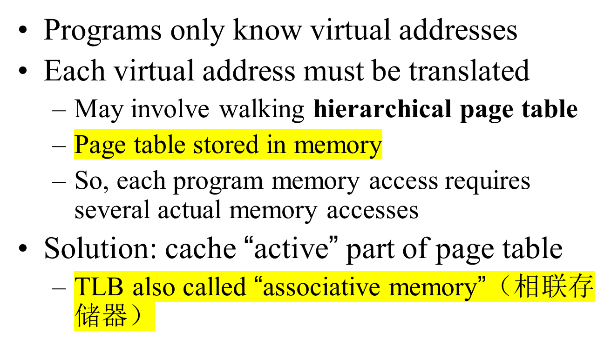
Virtual-To-Physical Lookups

Slide 55
Speeding Up Paging
Paging implementation issues:
The mapping from virtual address to physical address must be fast.
If the virtual address space is large, the page table will be large.

Slide 56
Translation Look-aside Buffer (TLB转换检测缓冲区）)
Virtual address
VPage #
offset
VPage#
PPage#
...
Real
page
table
VPage#
PPage#
...
Miss
.
.
.
VPage#
PPage#
...
TLB
Hit
PPage #
offset
Physical address

Slide 57
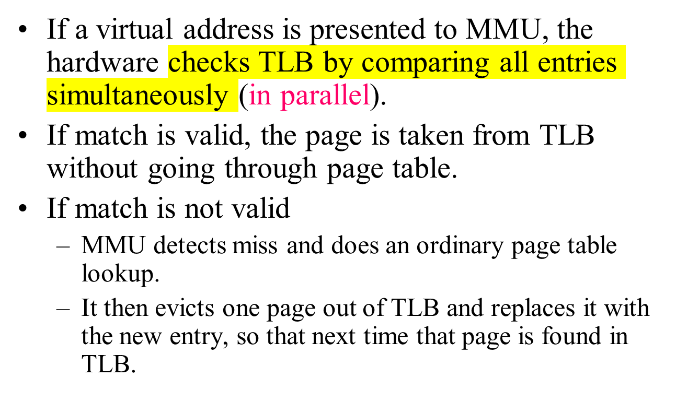
TLB Function

Slide 58
Bits in a TLB Entry
Common (necessary) bits
  Virtual page number（虚页号）: match with the virtual address
  Physical page number（物理页号）: translated address
  Valid（有效位，表示表项是否使用）
  Access bits（访问位）: kernel and user (nil, read, write)
Optional (useful) bits
  Process tag
  Reference
  Modify（修改位）
  Cacheable

Slide 59
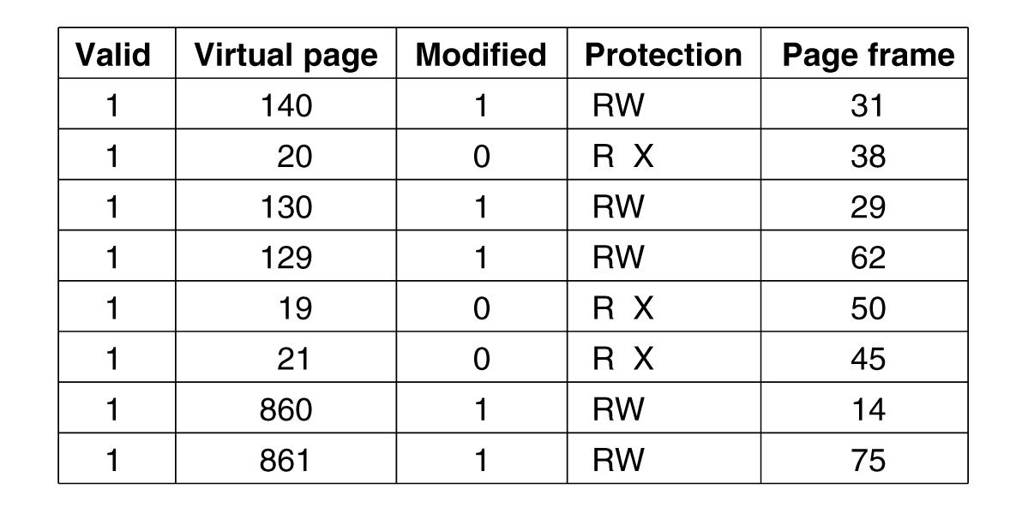
Translation Lookaside Buffers
Figure 3-12. A TLB to speed up paging.

Slide 60
Page Mapping Hardware
Virtual Memory Address (P,D)
Page Table
P
D
Associative Look Up
0
P
1
P
F
0
P-> F
First
1
1
0
1
F
D
Physical Address (F,D)
<number>/73

Slide 61
Page Mapping Example
Virtual Memory Address (P,D)
Page Table
004
006
Associative Look Up
0
1
12
4
1
7
4
6
9
0
First
19
3
004-> 009
1
3
7
1
0
Table organized by
LRU
1
009
006
Physical Address (F,D)
<number>/73
Notes:
First access, retrieve page from page table

Slide 62
Page Mapping Example: next reference
Virtual Memory Address (P,D)
Page Table
004
006
Associative Look Up
0
1
12
4
1
4
9
0
First
19
3
004-> 009
1
3
7
1
0
Table organized by
LRU
1
009
006
Physical Address (F,D)
<number>/73
Notes:
Second access, retrieve page from associative registers.

Slide 63
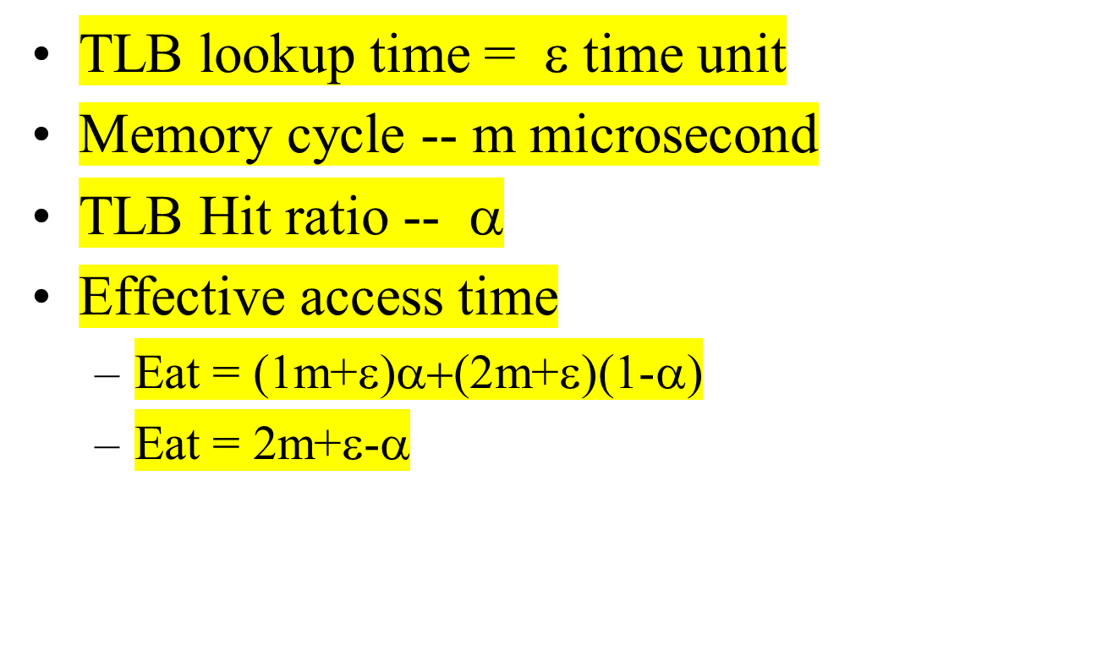
Effective Access Time
<number>/73
Notes:
This is how much access time is sped up when memory address is derefenced to physical address using an associative register.

Slide 64
Paging Implementation Issues
TLB can be implemented using
  Associative registers
  Look-aside memory
  Content-addressable memory
TLB hit ratio (Page address cache hit ratio)
  Percentage of time page found in associative memory

Slide 65
Hardware-Controlled TLB
On a TLB miss
  Hardware loads the PTE into the TLB
    Need to write back if there is no free entry
  Generate a fault if the page containing the PTE is invalid
  VM software performs fault handling
  Restart the CPU
On a TLB hit, hardware checks the valid bit
  If valid, pointer to page frame in memory
  If invalid, the hardware generates a page fault
    Perform page fault handling
    Restart the faulting instruction

Slide 66
Software-Controlled TLB
On a miss in TLB
  Write back if there is no free entry
  Check if the page containing the PTE is in memory
  If no, perform page fault handling
  Load the PTE into the TLB
  Restart the faulting instruction
  （不再是由MMU到页表中查找并取出需要的页表项，而是生成一个TLB失效并将问题交给操作系统解决）
On a hit in TLB, the hardware checks valid bit
  If valid, pointer to page frame in memory
  If invalid, the hardware generates a page fault
    Perform page fault handling
    Restart the faulting instruction

Slide 67
Hardware vs. Software Controlled
Hardware approach
  Efficient
  Inflexible（不灵活）
  Need more space for page table
Software approach
  Flexible（灵活)
  Software can do mappings by hashing
    PP# → (Pid, VP#)
    (Pid, VP#) → PP#
  Can deal with large virtual address space

Slide 68
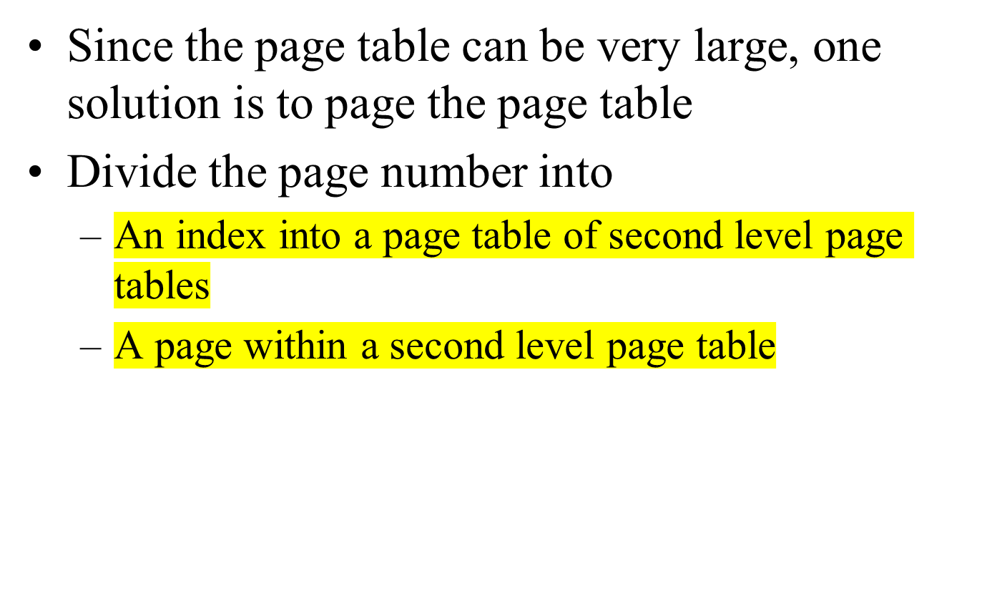
Multilevel Page Tables
<number>/73

Slide 69
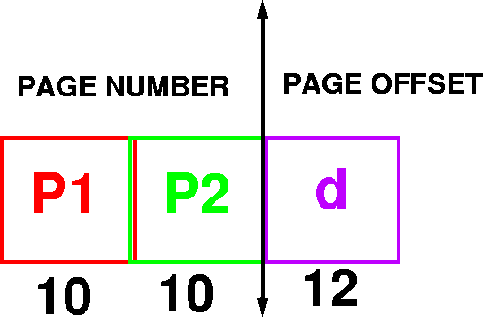
Example Addressing on a Multilevel Page Table System
A logical address (on 32 bit machine with 4k page size) is divided into
  A page number consisting of 20 bits
  A page offset consisting of 12 bits
Divide the page number into
  A 10-bit page number
  A 10-bit page offset
<number>/73

Slide 70

Multilevel Page Tables
(b)
Figure 3-13. (a) A 32-bit address with two page table fields.
(b) Two-level page tables.

Slide 71

Main idea
  One PTE for each physical page frame
  Hash (Vpage, pid) to Ppage#
Pros
  Small page table for large address space
Cons
  Lookup is difficult
  Overhead of managing hash chains, etc
Physical
address
Virtual
address
pid
vpage
offset
k
offset
0
pid
vpage
k
n-1
Inverted page table
<number>/73

Slide 72
Inverted Page Table
Virtual Address (004006)
Page Table
004
006
0
1
5
0
1
4
1
0
1
005
006
Physical Address (005006)
<number>/73

Slide 73
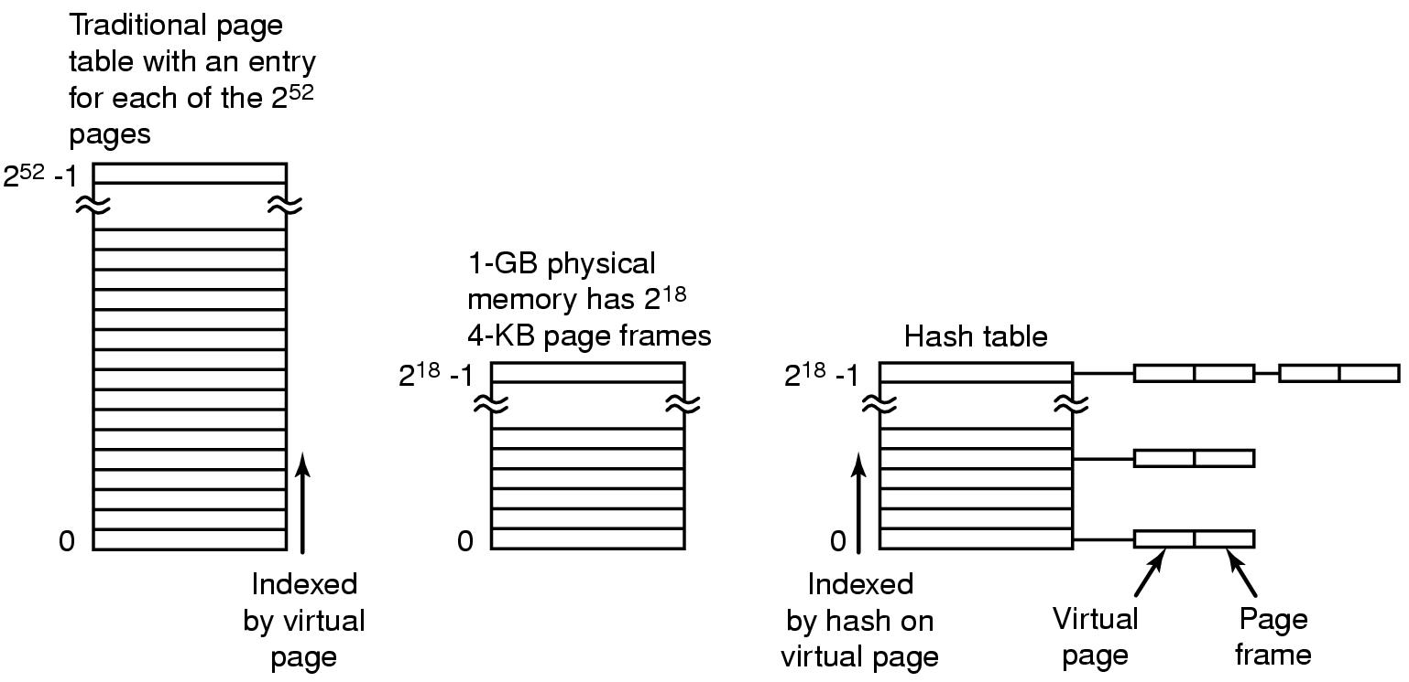
Inverted Page Tables
Figure 3-14. Comparison of a traditional page table
with an inverted page table.

Slide 74
Issues
What TLB entry to be replaced?
  Random
  Pseudo LRU
What happens on a context switch?
  Process tag: change TLB registers and process register
  No process tag: Invalidate the entire TLB contents
What happens when changing a page table entry?
  Change the entry in memory
  Invalidate the TLB entry

Slide 75




Page Replacement
Find location of page on disk
Find a free page frame
  If free page frame use it
  Otherwise, select a page frame using the page replacement algorithm
  Write the selected page to the disk and update any necessary tables
Read the requested page from the disk.
Restart the user process.
It is necessary to be careful of synchronization problems. For example, page faults may occur for pages being paged out.
<number>/73

Slide 76
Summary
Review
No Memory Abstraction
Memory Abstraction: address space
  address space
  Swapping
  Memory Management (free space)
Virtual Memory and Paging
  Overlaying
  Paging
  Page Table and TLB
Page Replacement
P142-145: 3,4,22，24，25，28，30，35，36，41，47

